Slide 1


SmartQuizzer: Your Adaptive AI Quiz Platform
Welcome to SmartQuizzer, an innovative platform designed to transform the learning experience through intelligent, adaptive quizzing.

Slide 2
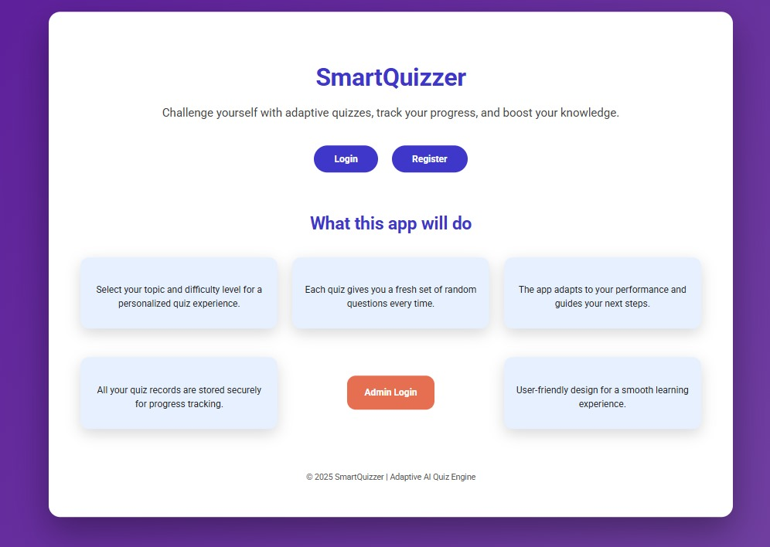
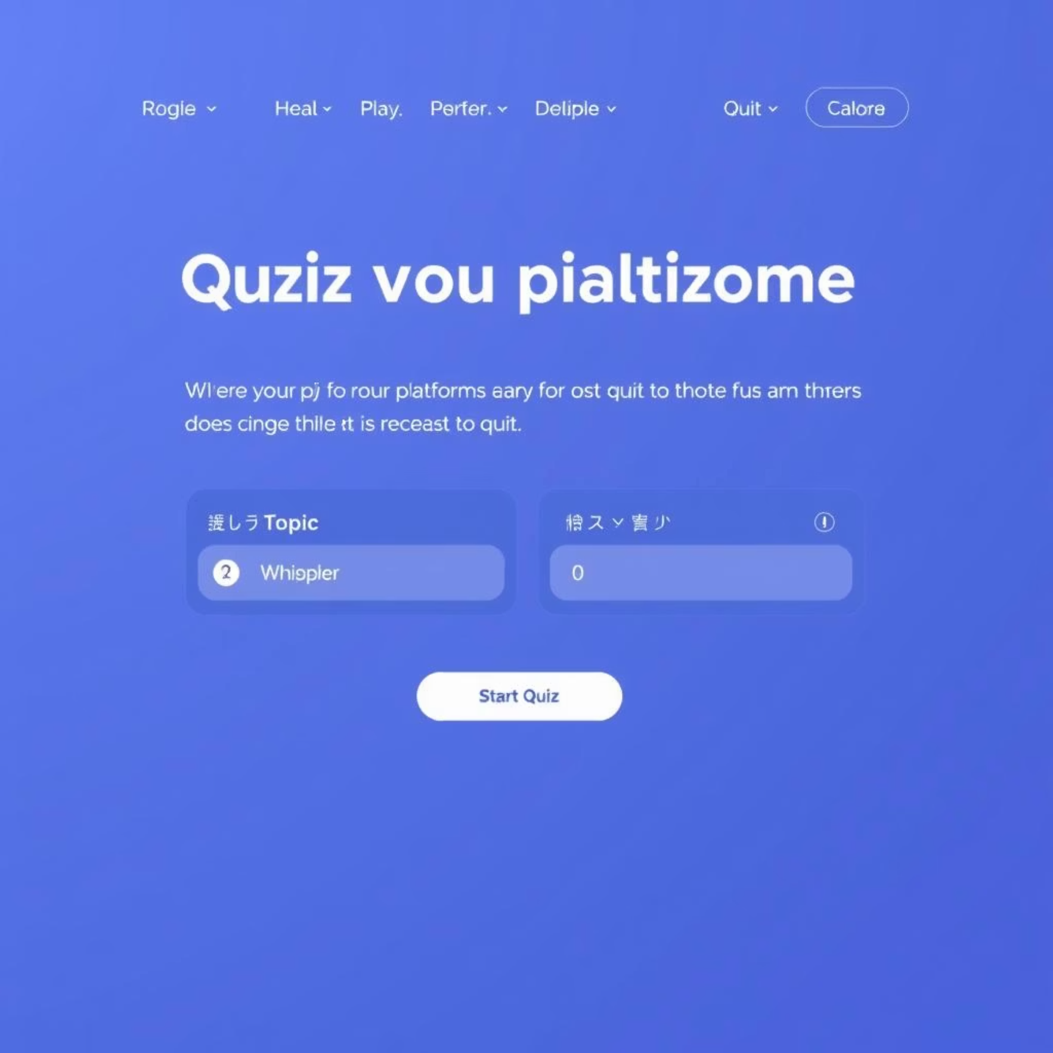



Adaptive Learning at Your Fingertips
SmartQuizzer leverages AI to provide personalized quizzes, track your progress, and deliver tailored feedback, ensuring an effective and engaging learning journey.
Choose topic and difficulty for personalized quizzes.
Receive a fresh set of random questions every time.
AI-Powered Adaptation
Seamless Progress Tracking
Intuitive User Experience
Our AI dynamically adjusts to your performance, guiding you through your unique learning path for optimal progress.
All your quiz records are securely stored, allowing you to monitor your growth and review past performance effortlessly.
Designed for simplicity, SmartQuizzer offers a smooth and friendly interface for all users, from registration to quiz completion.

Slide 3
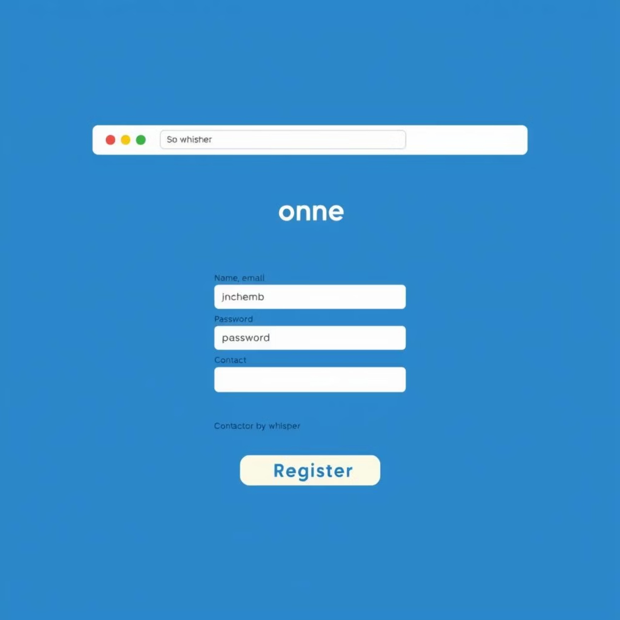
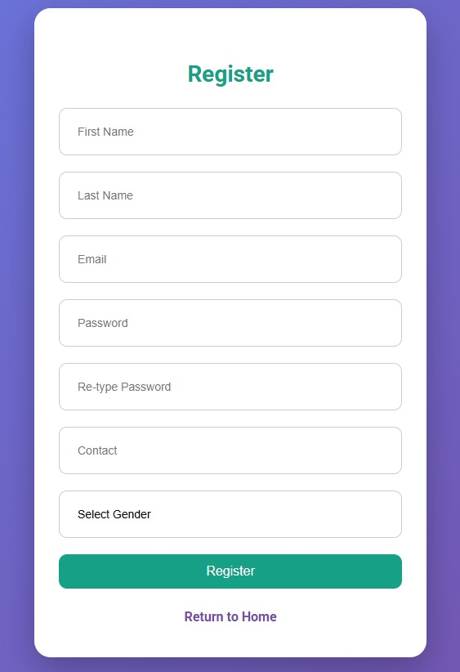
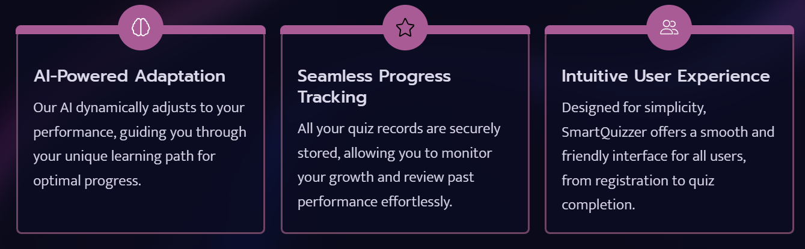
Getting Started
Seamless Onboarding for New Users
New students can easily create an account to access
all the features of SmartQuizzer. Our straightforward registration process ensures you can start learning without delay.
Access registration from the Home Page.
Fill in basic details for secure account creation.
Confirm password and contact information.
Your learning journey begins here.

Slide 4
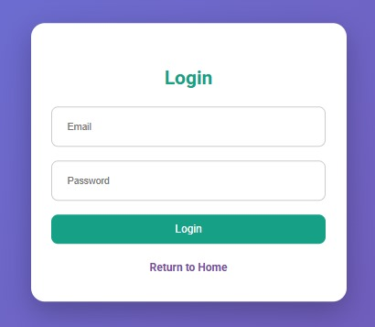

User Access
Secure Login for Existing Students
For returning students, logging in is quick and secure. Simply enter your credentials to pick up where you left off and continue your quiz sessions.
Quickly return to your dashboard or quizzes.
Direct access from the Home Page.
Requires only email and password for authentication.
Student Login
Admin Login
Personalized access to quizzes and performance data.
Dedicated portal for faculty to manage content and users.

Slide 5
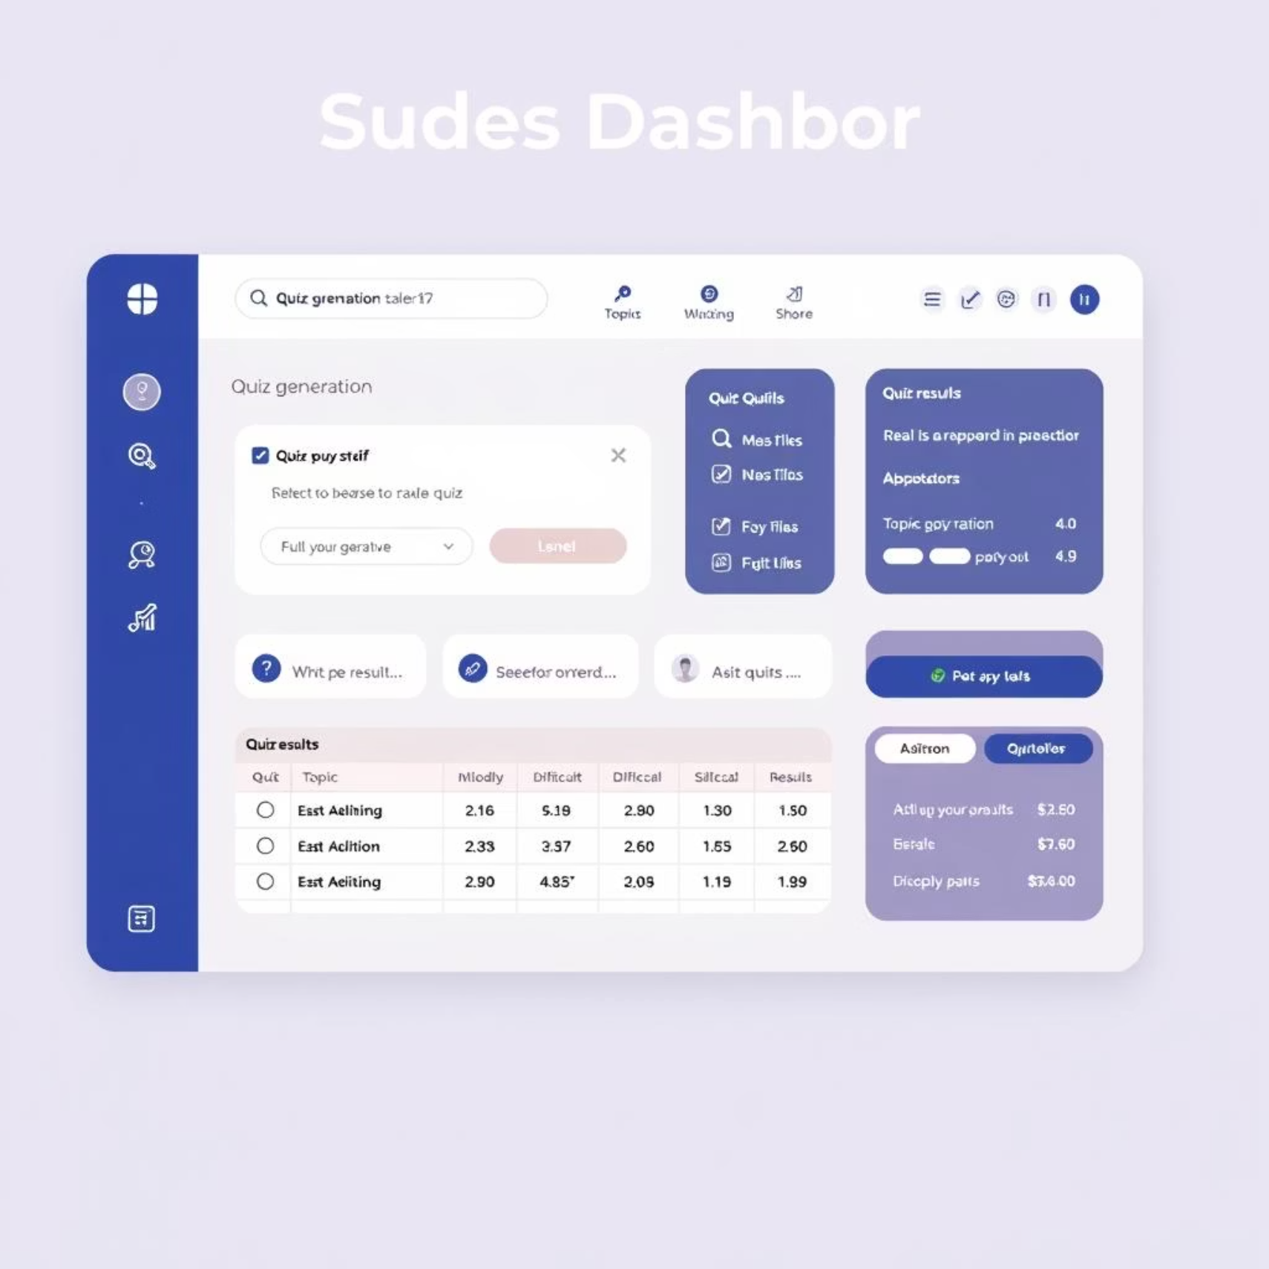
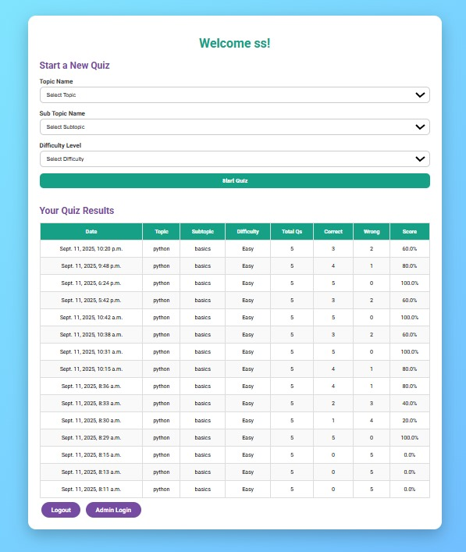
Student Experience
Your Personalized Learning Hub
The Student Dashboard is your central hub for learning. Here, you can tailor your quizzes and review your comprehensive performance history.
Select Topic, Subtopic, and Difficulty Level.
Generate quizzes instantly with "Start Quiz."
View detailed quiz history, scores, and accuracy.
This dashboard empowers students to take control of their learning, identifying strengths and areas for improvement with ease.

Slide 6
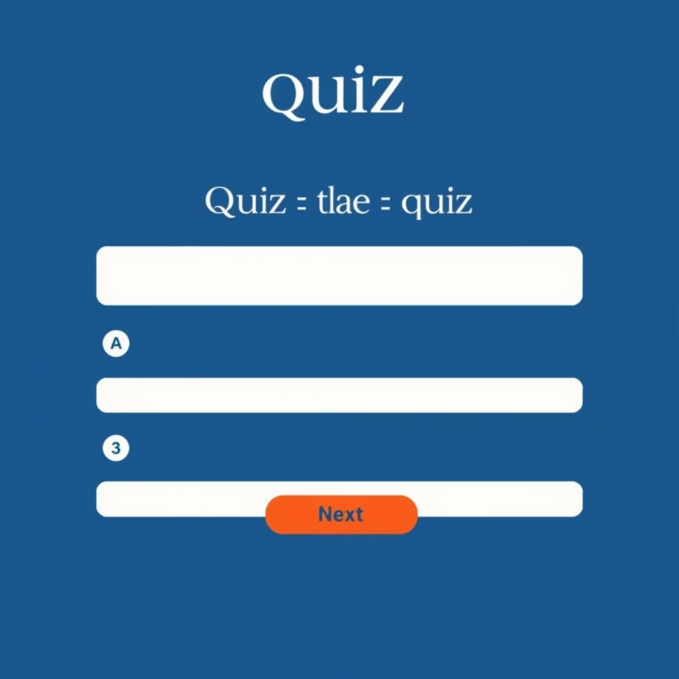
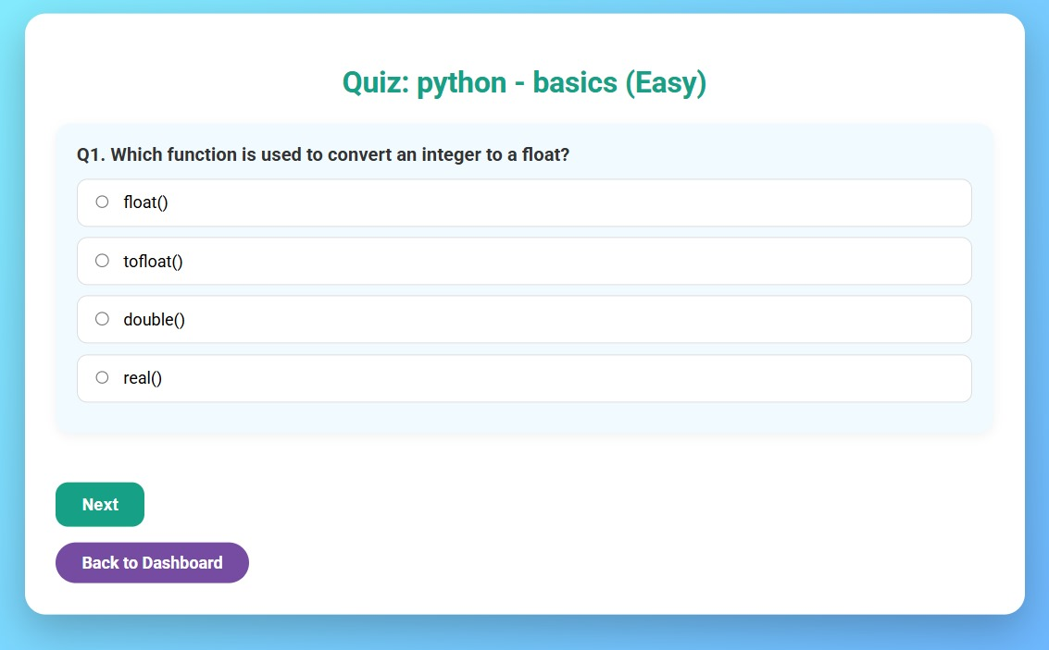
Interactive Quizzing
Focused Learning, Question by Question
The quiz interface is designed for maximum concentration. Questions are presented one at a time, allowing you to fully engage with each item before moving on.
Dynamically generated based on your dashboard
selections.
Clear display of topic, subtopic, and difficulty.
Single-question view with multiple-choice options.
Master complex concepts with a clear, guided approach.

Slide 7
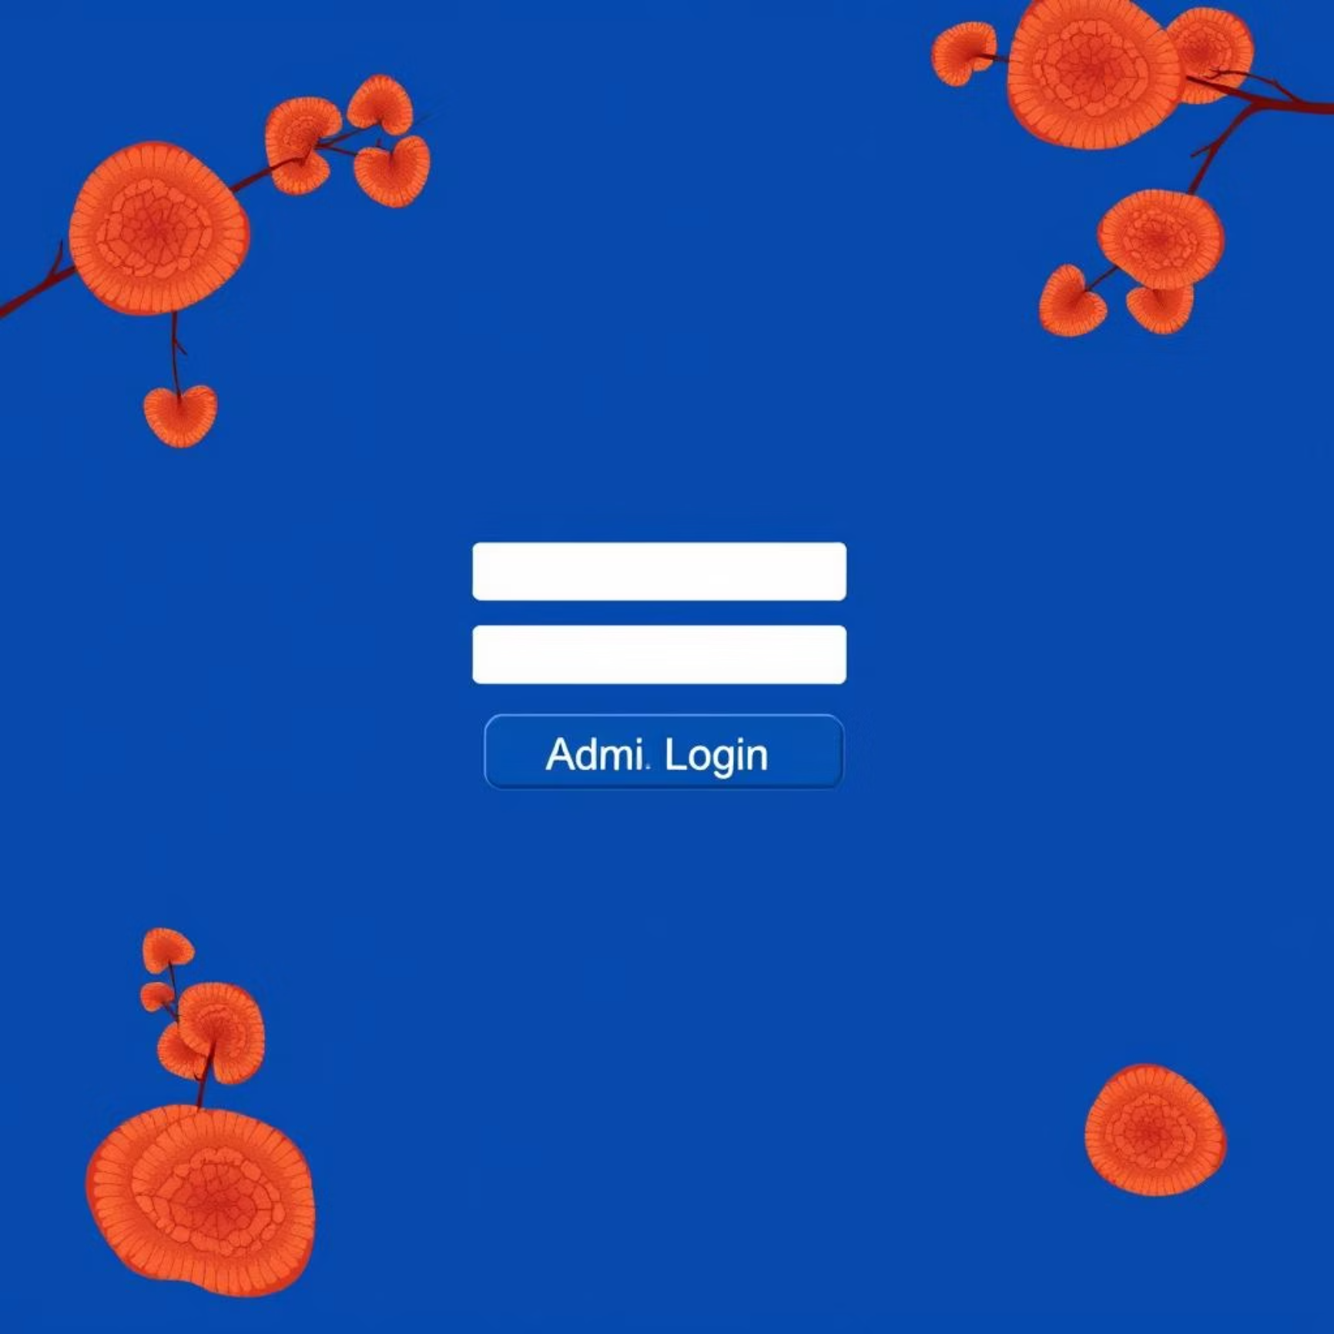
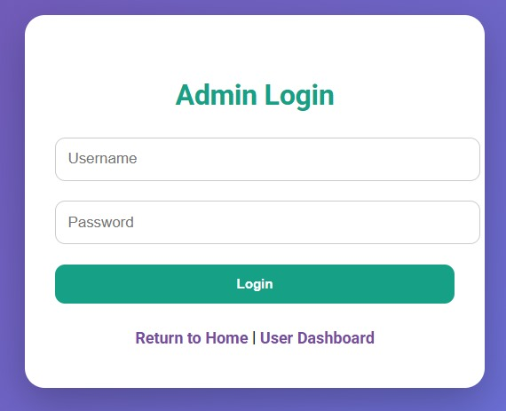

Faculty Access
Empowering Educators: Admin Login
The Admin Login provides faculty with secure access to manage the SmartQuizzer platform. From here, educators can oversee content, track student performance, and customize settings.
Accessible directly from the Home Page.
Requires unique username and password for
authentication
Leads directly to the comprehensive Admin Dashboard.
Faculty can seamlessly transition between admin and user dashboards for holistic platform management.

Slide 8
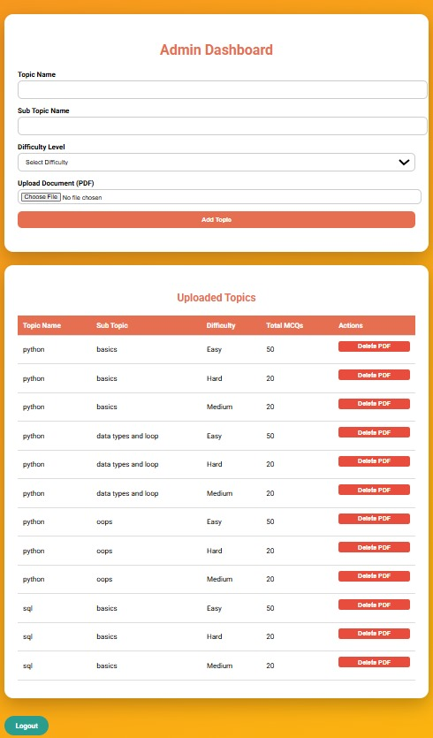
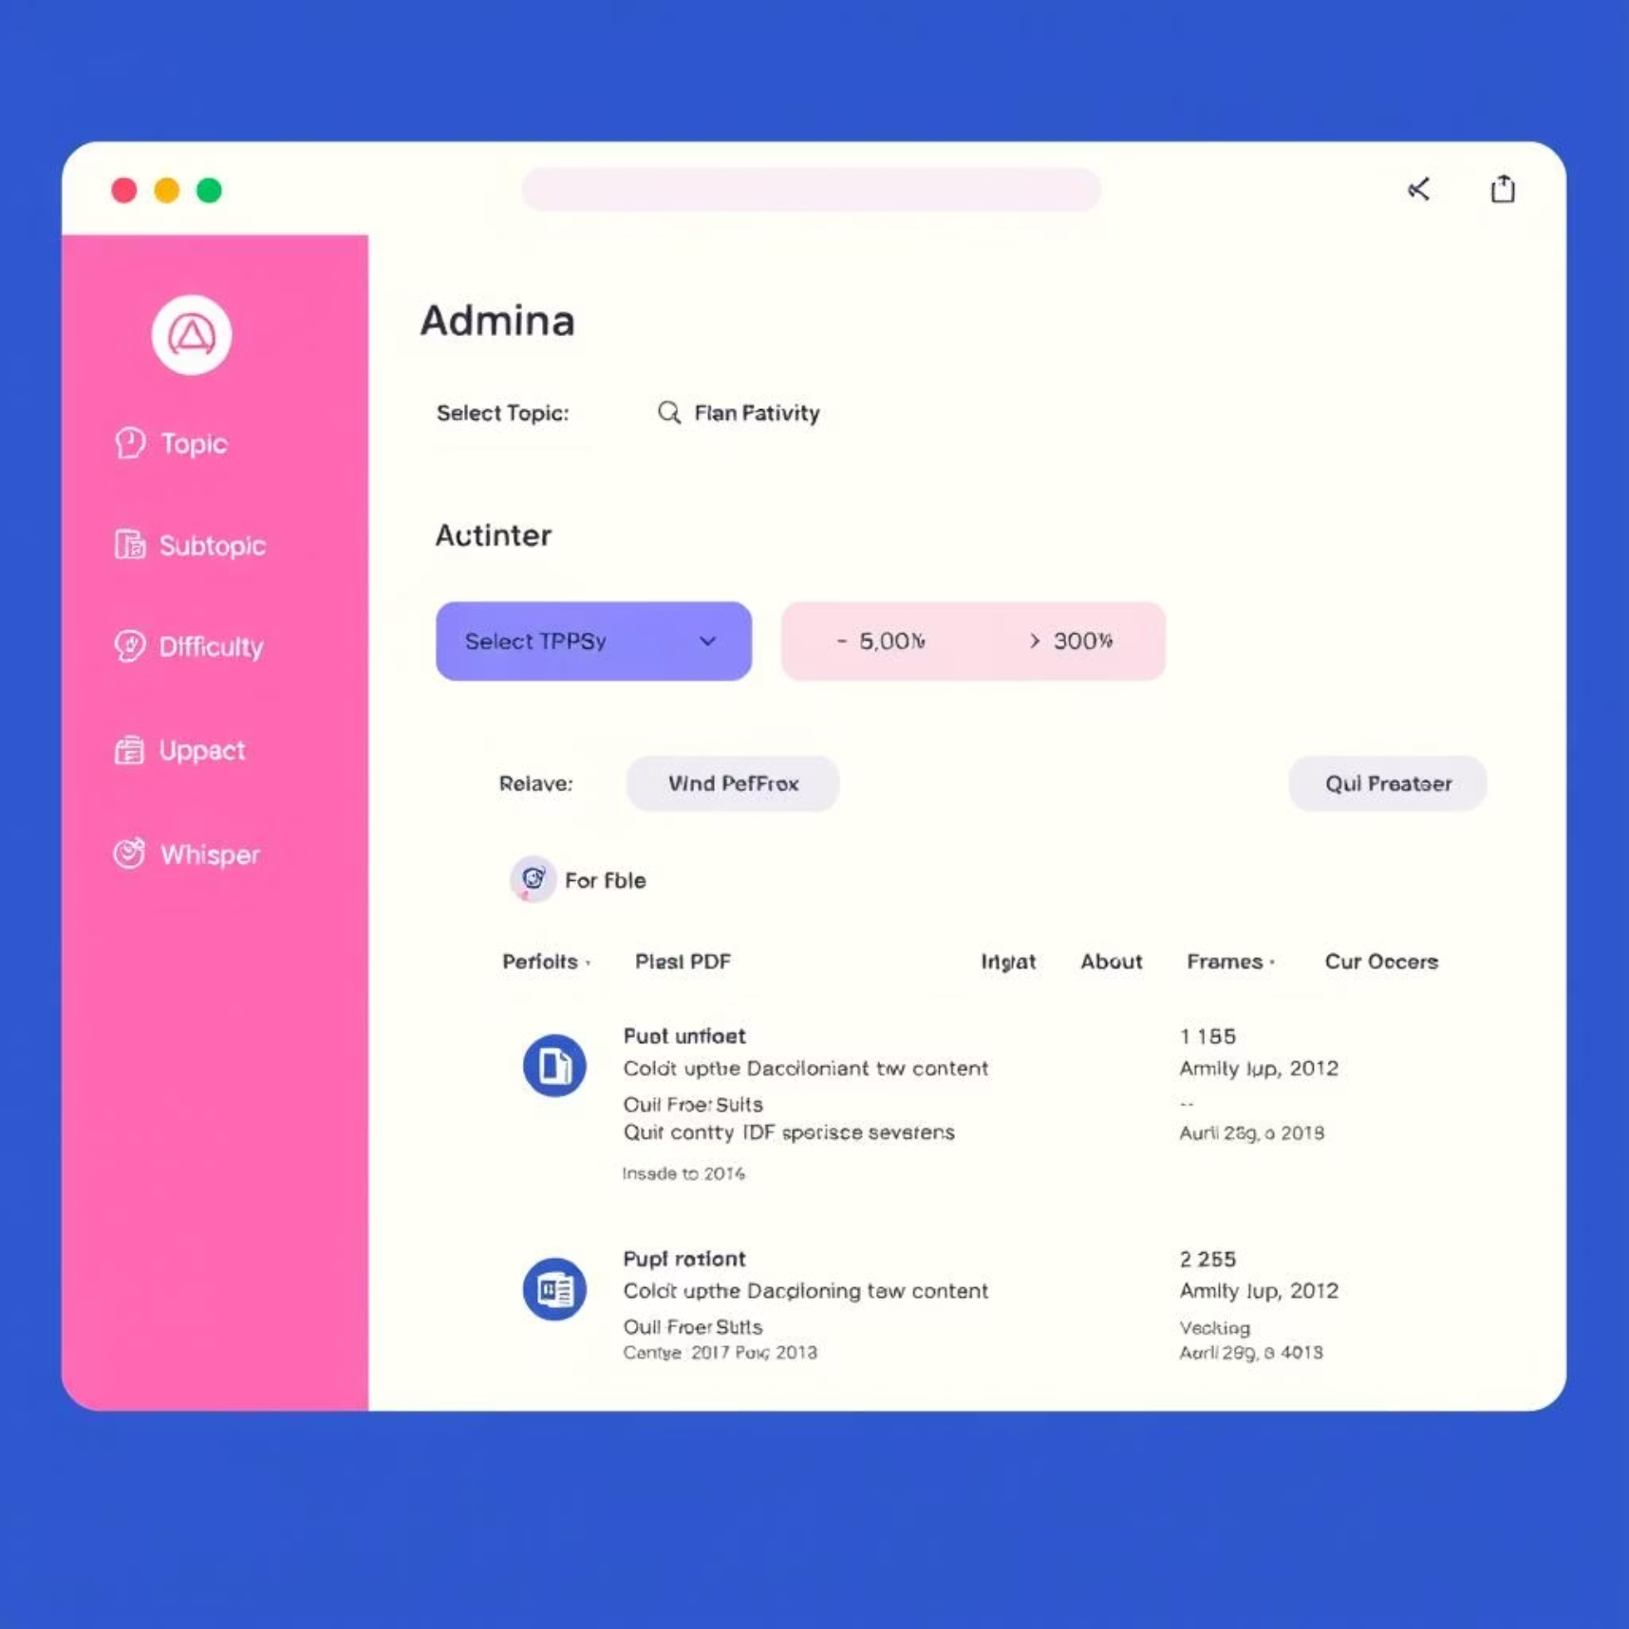
Comprehensive Content
Management
The Admin Dashboard is the central control panel for faculty. It enables efficient management of quiz content, ensuring the platform remains up-to-date and relevant.
Upload new questions via PDF format.
Add and organize topics and subtopics.
View and manage all uploaded quiz content.
This dashboard streamlines the process of keeping educational materials current and tailored to specific learning needs.

Slide 9
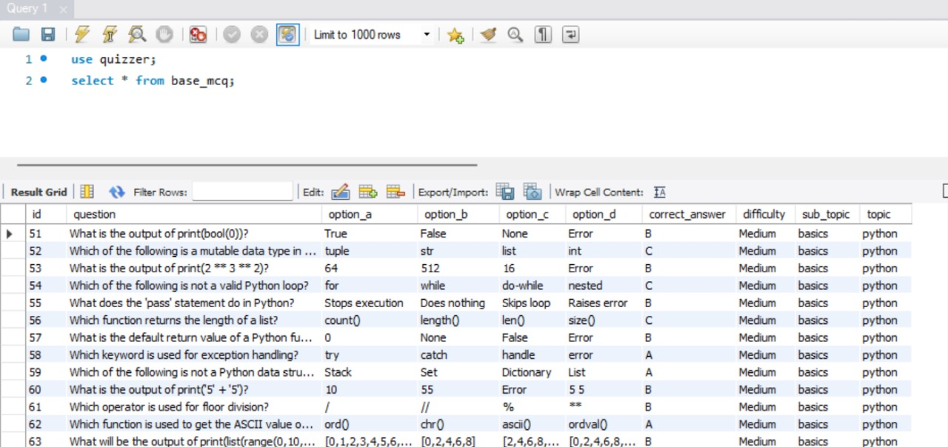
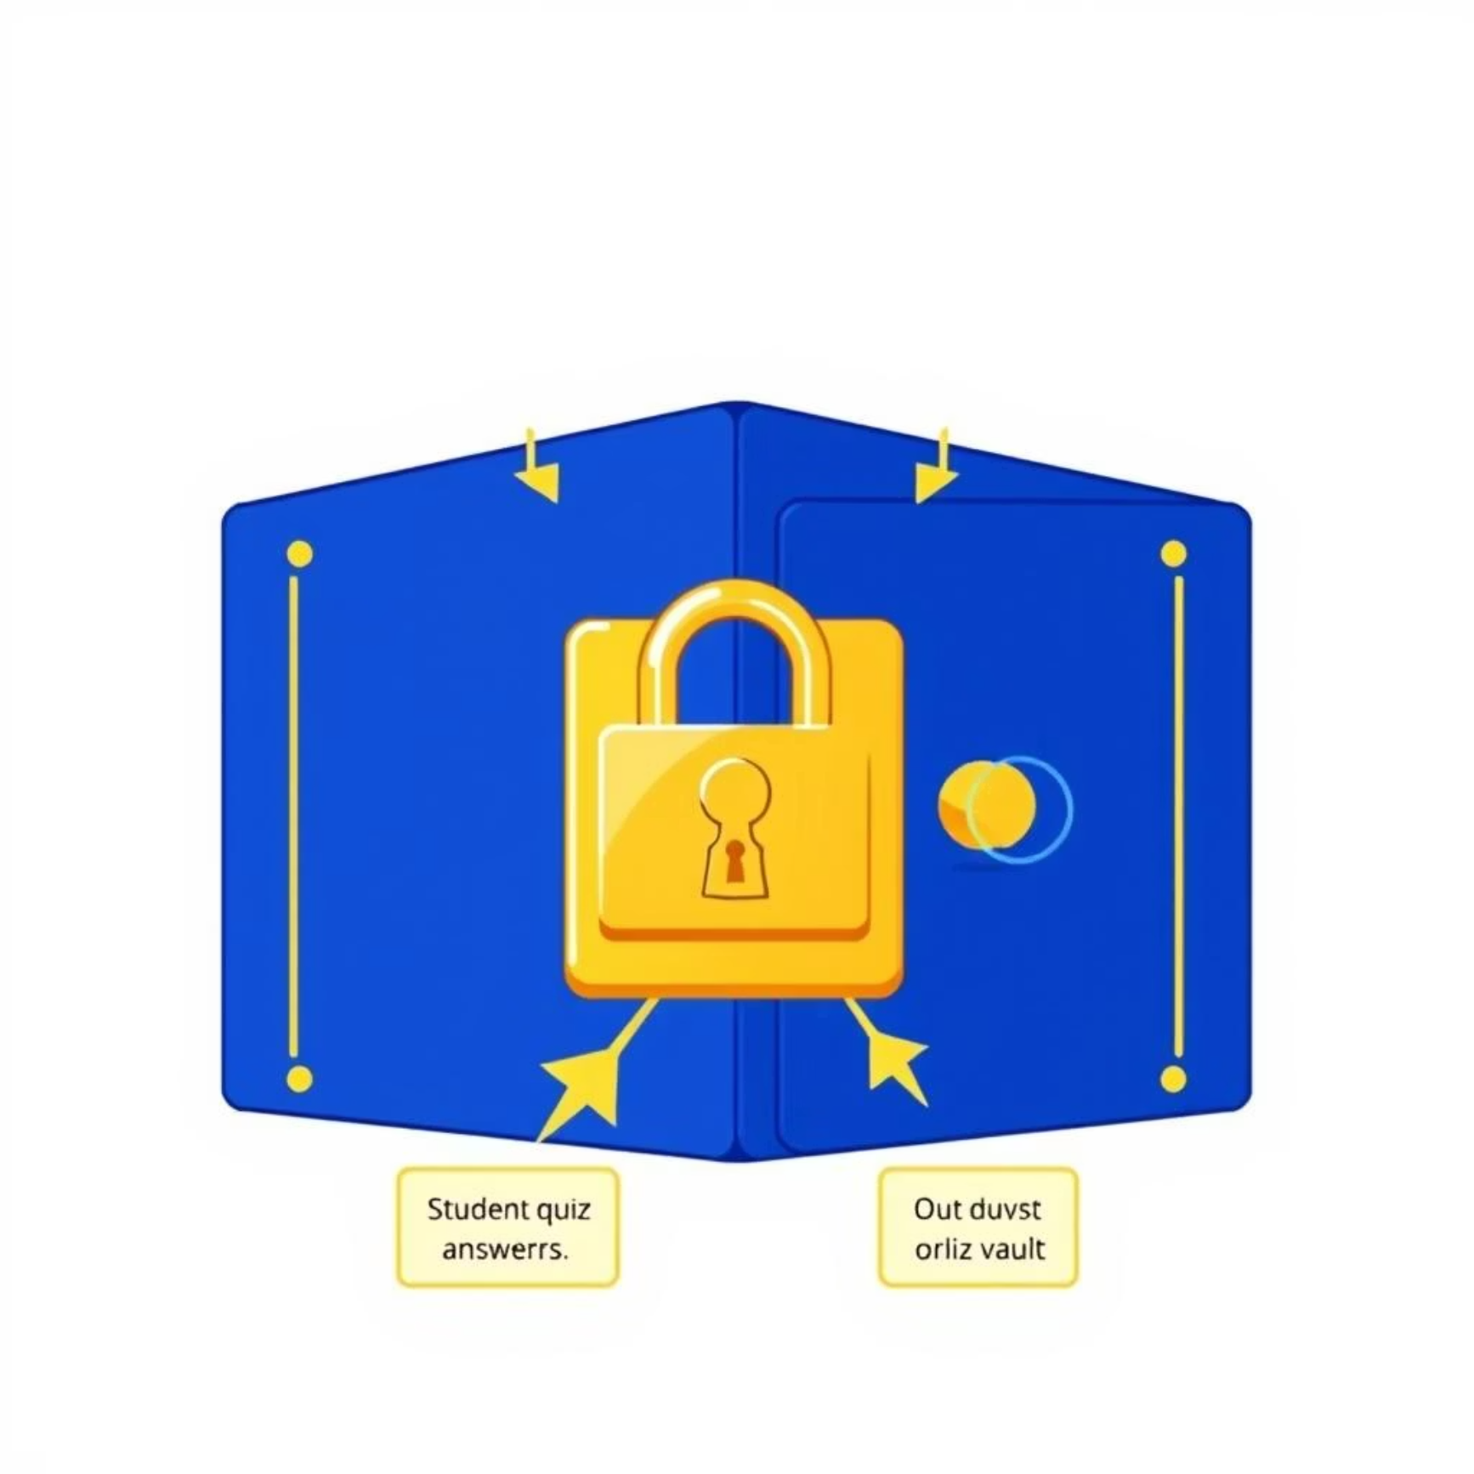
Data & Infrastructure
Secure and Robust Data Management
SmartQuizzer is built on a robust and secure database infrastructure. All student answers, quiz results, and user data are meticulously stored and managed.
Records individual student responses for detailed
analysis.
Maintains a comprehensive history of all quiz attempts.
Ensures data integrity and security for academic
purposes.
Reliable data underpins adaptive learning.

Slide 10
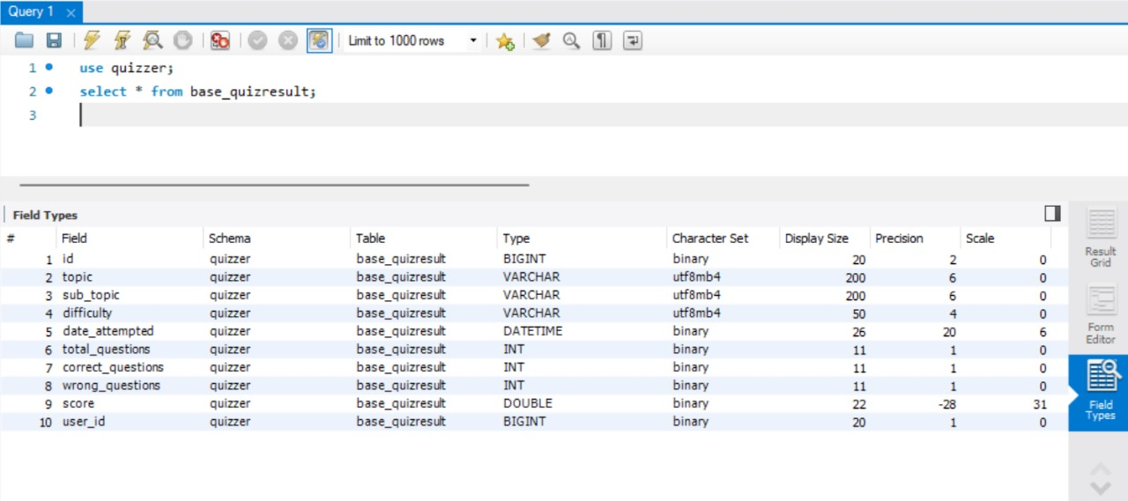
Secure and Robust Data Management
Records individual student responses for detailed
analysis.
Maintains a comprehensive history of all quiz attempts
Ensures data integrity and security for academic
purposes.

Slide 11
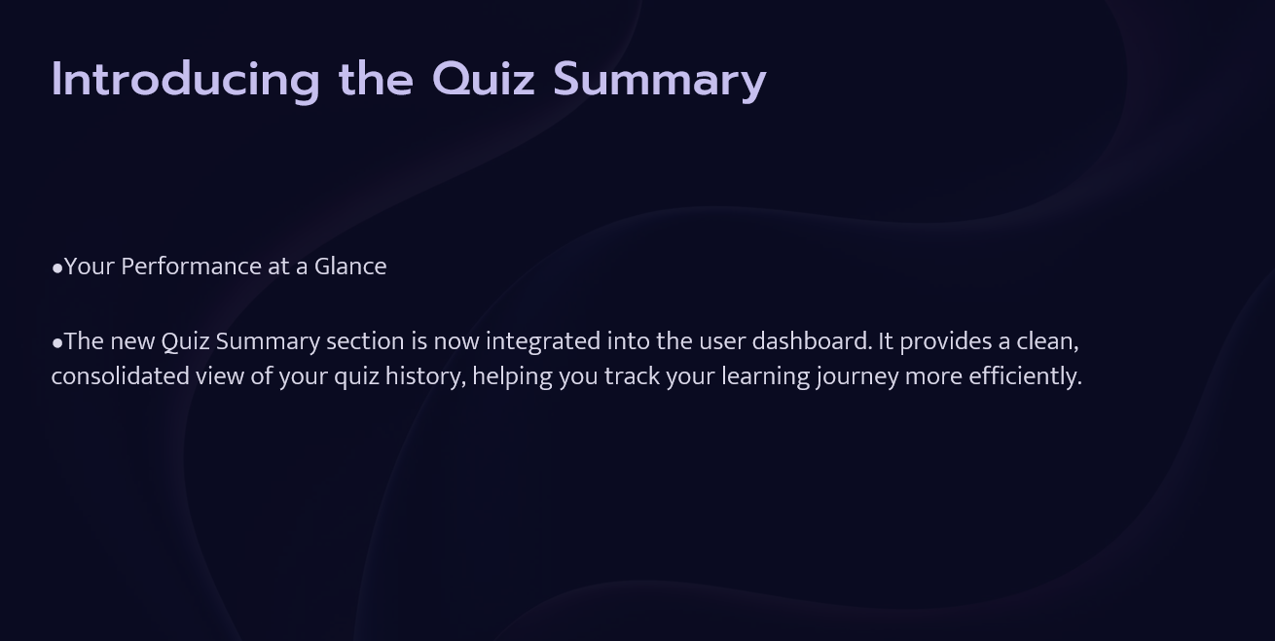

Slide 12
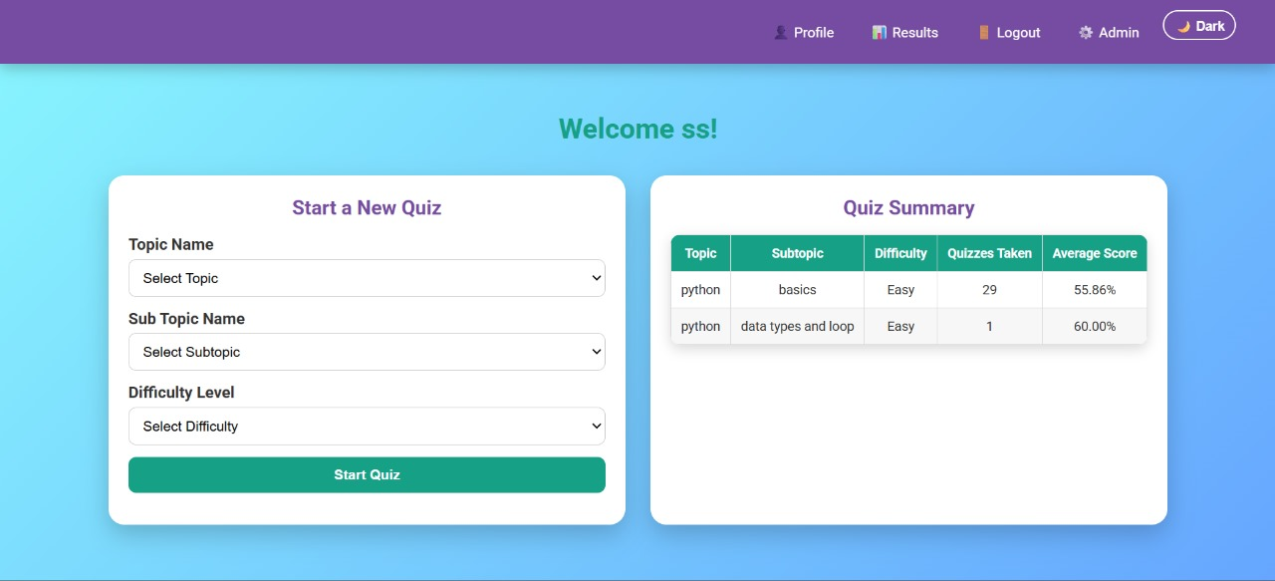

USER DASHBOARD

Slide 13
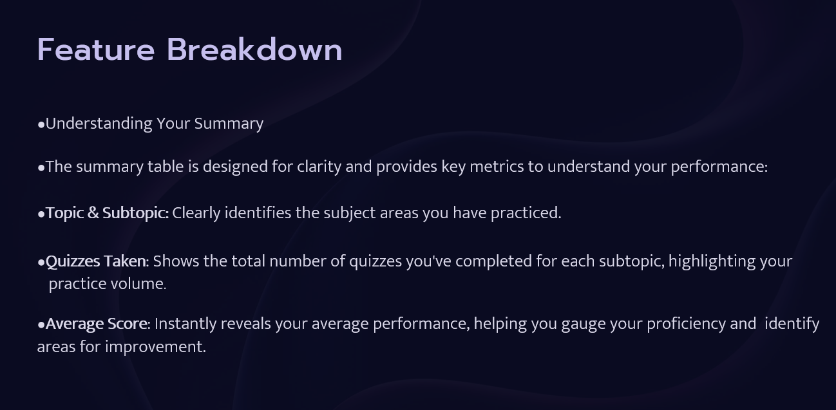

Slide 14
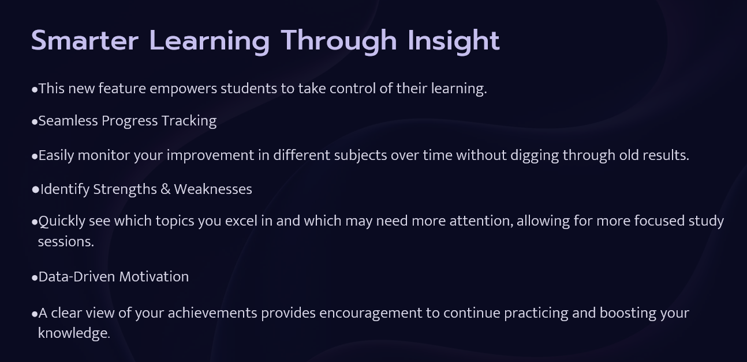

Slide 15
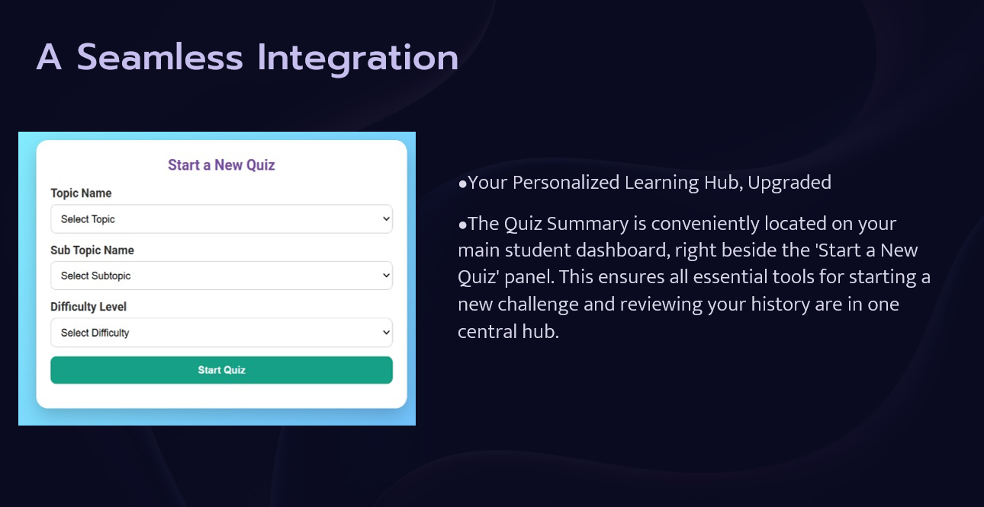

Slide 16
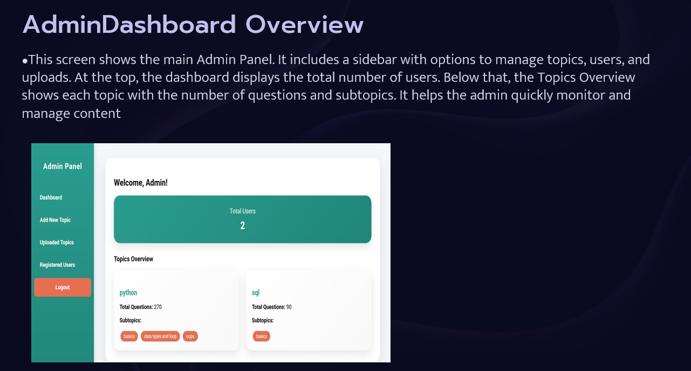

Slide 17
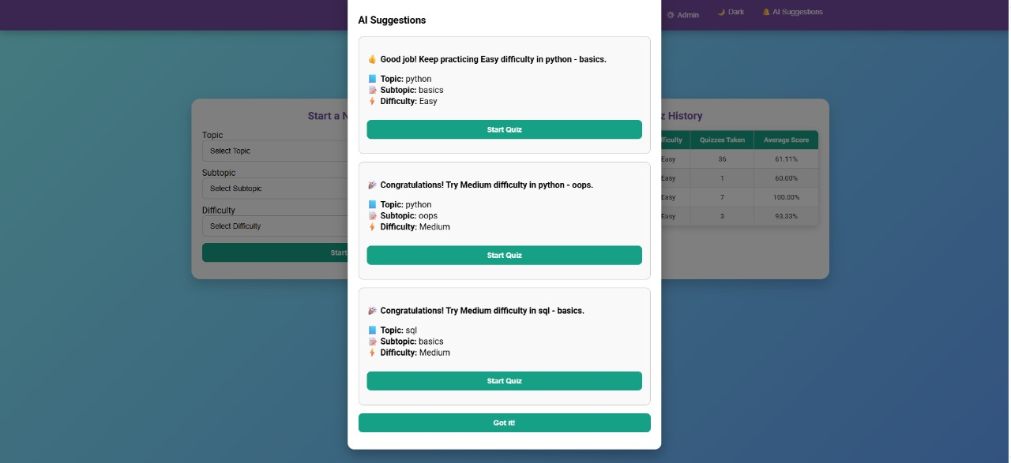
Quick AI Suggestion

Slide 18
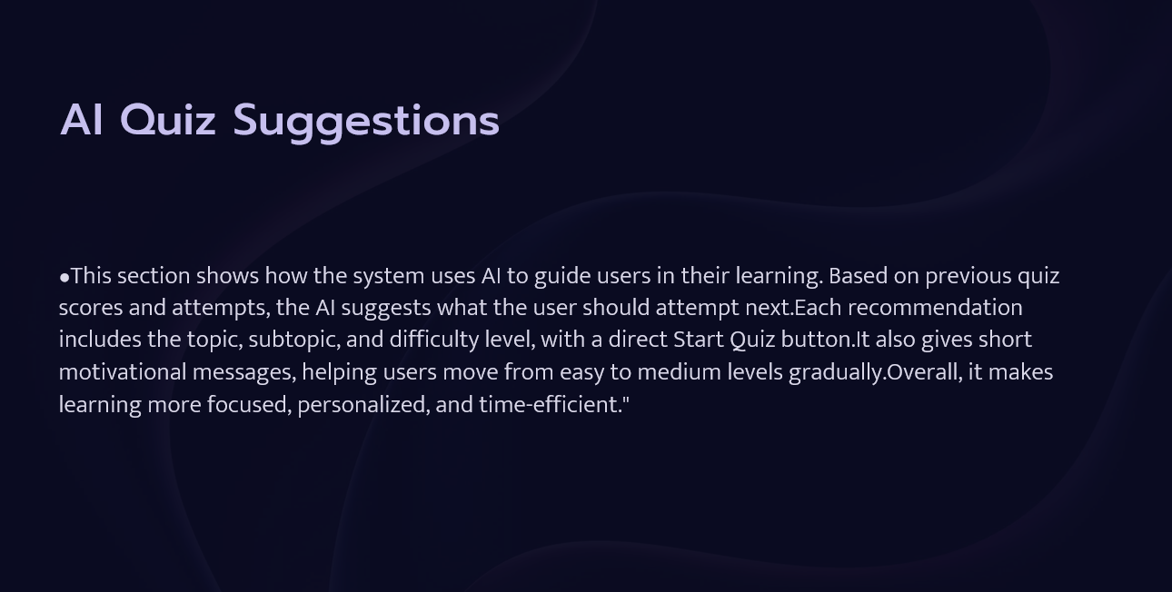

Slide 19
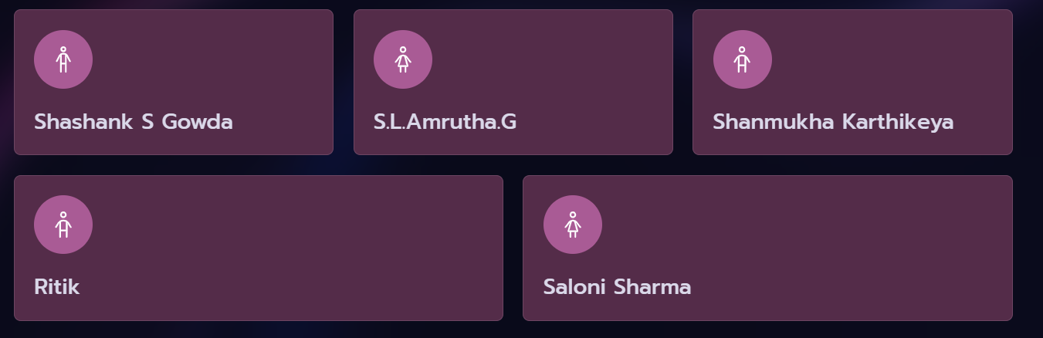





Our Visionaries
The SmartQuizzer Development Team
Shashank S Gowda
S.L.Amrutha.G
Shanmukha Karthikeya
Ritik
Saloni Sharma
We extend our sincere gratitude for your attention and interest in SmartQuizzer.

Slide 20


